Slide 1




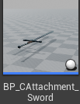
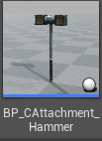
Player
Equipment
Data
Equipment
Weapon
Component
Weapon
Asset
Attachment
Enemy
Act
Data
Act
A
B
: B가 A의 멤버
Hit
Data

